Slide 1
Graph Neural Networks: Theoretical Foundations & Applications
Sidharth SS (IISER, Mohali)

Slide 2
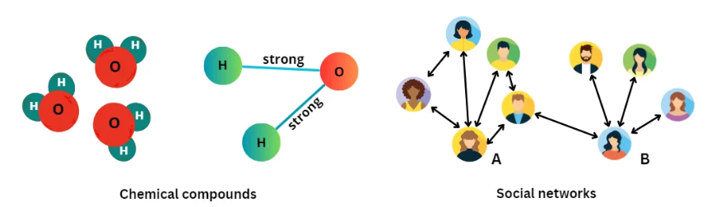
Introduction to Graphs and GNNs
What is a Graph?
Nodes (vertices) and edges represent entities and relationships
Real-life examples: social networks, molecules, etc.
Why GNNs?
Leverage the inherent structure of graph data
Learn spatial and structural features that standard neural networks might miss
Image Source: https://medium.com/@bscarleth.gtz/

Slide 3
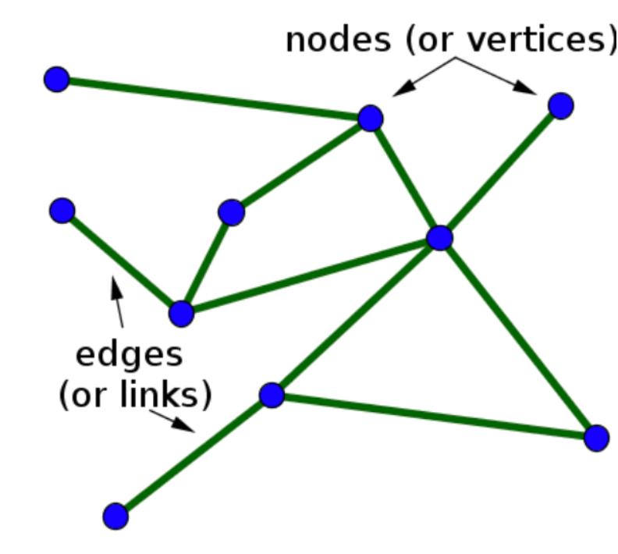
Graph Representations
Components of a Graph:
Nodes: Entities with features (vectors) x_{i}​∈ℝ^{d}
Edges: Can also have features (e.g., bond type)
Image source: https://blog.fastforwardlabs.com/

Slide 4
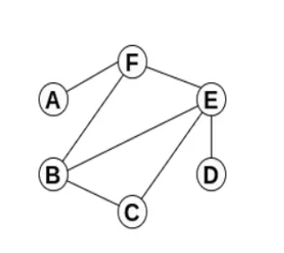
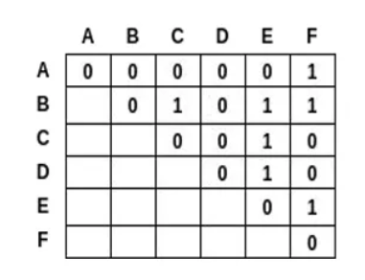
Graph Representations
Adjacency Matrix:
Represents connectivity (1 if connected, 0 if not)
Often augmented with self-loops to include a node’s own features
Image source: https://medium.com/@ahmedmellit/

Slide 5
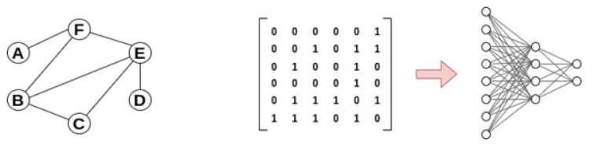
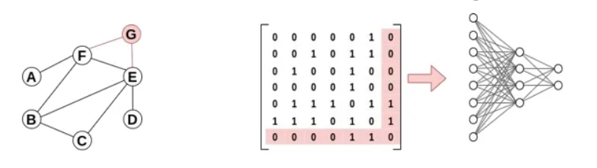
What Next?
We have a matrix, so let’s use a kernel to extract local features—like in image convolution, right?
The Problem: Input Size Varies!
Different graphs = different adjacency matrix dimensions (e.g., a small molecule with 5 atoms vs. a bigger one with 50).
Image source: https://medium.com/@ahmedmellit/

Slide 6
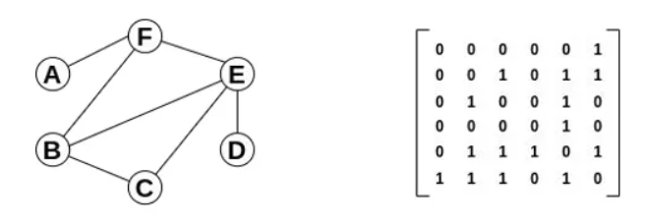
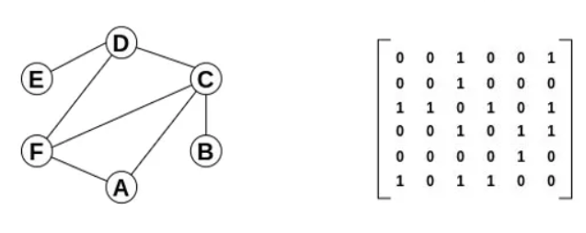
Problem #2
There is no single “canonical” ordering of nodes.
Image source: https://medium.com/@ahmedmellit/

Slide 7
The Solution: Message Passing
Message Passing:
Each node gathers information (messages) from its neighbors.
Process Steps:
Message: Transform neighbor node features into messages.
Aggregation: Combine messages using a permutation invariant function.
Update: Update the node’s own representation using the aggregated message.

Slide 8
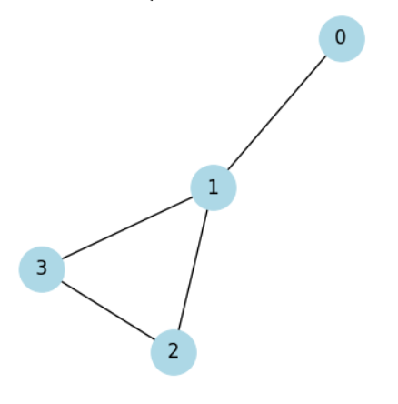
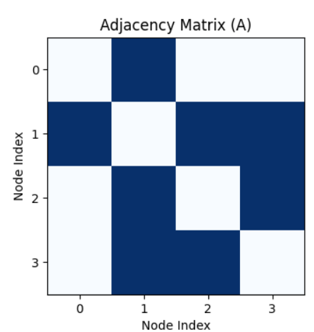
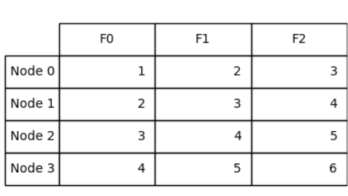
Let’s Understand the Math
Each node has 3 features, meaning it contains 3 numbers
Shape of A: A∈ℝ^{NXN}
Shape of feature vector_{i}: x_{i}​∈ℝ^{d}

Slide 9

Let’s Understand the Math
Message Function
The messag from node ｊ to node ί is computed as:
Where F is a learnable transformation applied to the feature vector x_{j} of node j. A common choice for F is a simple affine transformation:
or, for mathematical convenience:

Slide 10
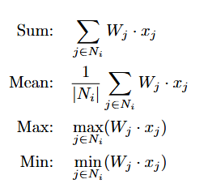
Let’s Understand the Math
Aggregation Function
Once messages are computed from neighbouring nodes, they are aggregated using a function G:
where N(ί) is the set of neighbors of node i. Common choices for G include:

Slide 11
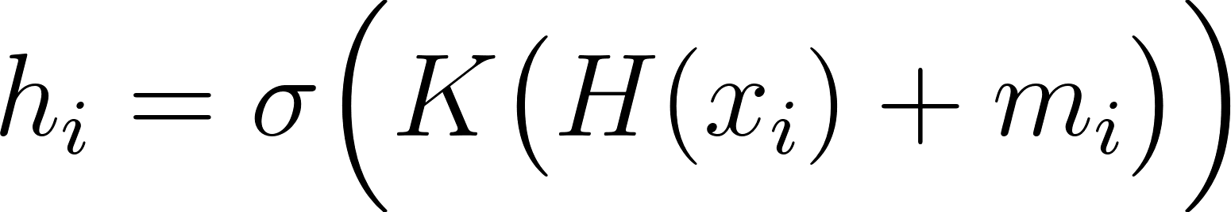
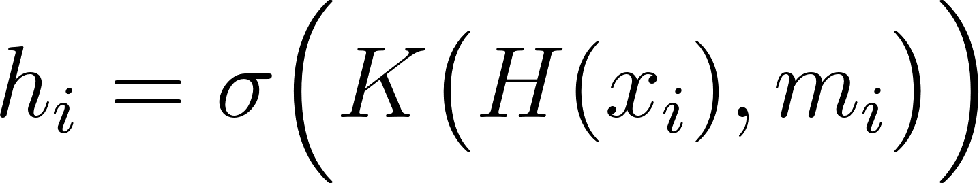
Let’s Understand the Math
Update Function
The aggregated message is then combined with the node’s own feature representation:
where H is a transformation applied to x_{i}, and K is a projection function that
integrates the messages and node features together.
Alternatively, the update can be expressed as:

Slide 12
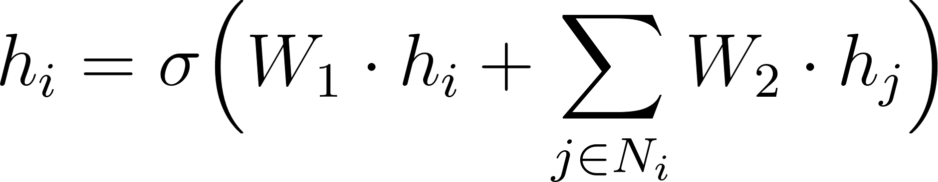
Final Formulation
Bringing together the message passing, aggregation, and update steps, a single
GNN layer can be expressed as:

Slide 13
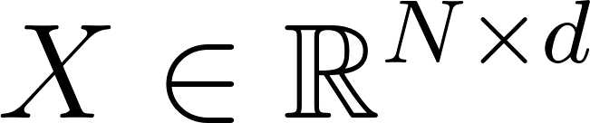
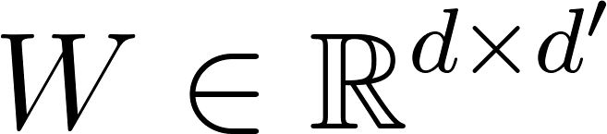
Let’s vectorize!
Now that we have all the necessary components, we need to structure them for
practical implementation in code.
Each node i has a feature vector x_{i} of shape R^{d}, where d is the number of
features. Stacking all N node features together forms the feature matrix:
For transformation during message passing, we introduce a weight matrix W with shape:
where d′ is the output (hidden) dimension.

Slide 14
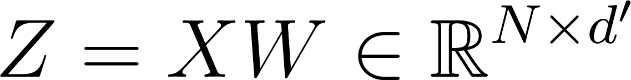
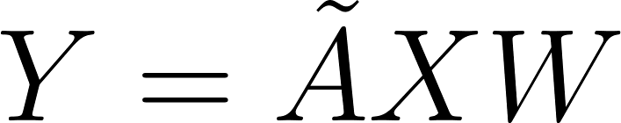
Let’s vectorize!
Multiplying this weight matrix with X gives:
To incorporate edge embeddings, we use the adjacency matrix, which has a shape R^{NXN}
The message-passing step then becomes:
Where is defined as:
to include self-loops. Without self-loops, the transformation would only involve
N − 1 neighbors, requiring an explicit addition of the node’s own contribution.

Slide 15
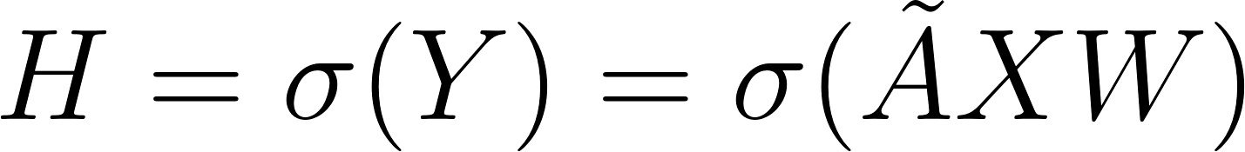
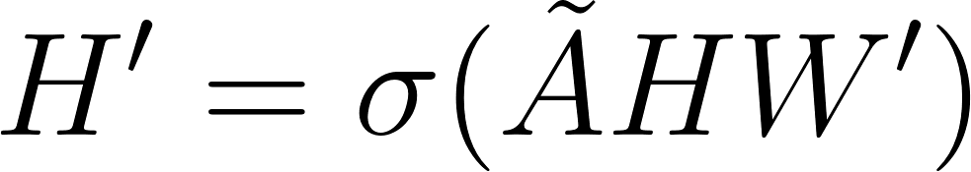
Let’s vectorize!
Finally, applying an activation function yields:
which can be further passed to subsequent layers:

Slide 16
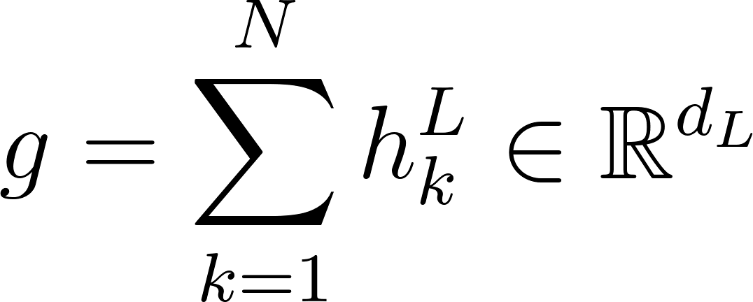
GNN Application
Graph Level Representation
One way to obtain a representation for the entire graph is by aggregating node
features along the first axis:
This provides a compact feature representation of the entire graph, which can
be used for tasks like graph classification (e.g., molecular property prediction).

Slide 17
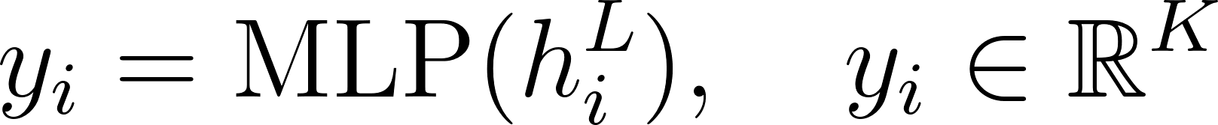
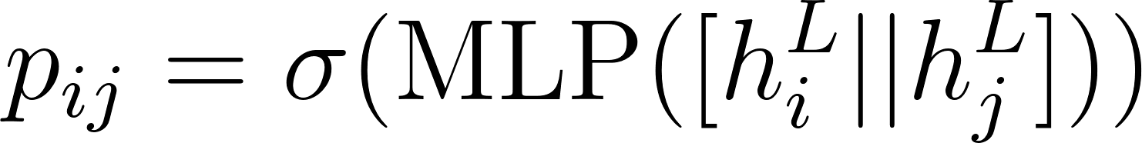
GNN Application
Node Classification
For node classification, we classify each node into one of K classes:
This is useful in applications such as molecular property prediction, where each
node may represent an atom (e.g., Carbon, Oxygen, Hydrogen)
Link Prediction
To determine if an edge should exist between nodes i and j, we use their em-
beddings in a neural network:
where || represents concatenation and σ is a sigmoid activation function. This is useful for applications like predicting molecular interactions or social network link predictions.

Slide 18
References
A Gentle Introduction to Graph Neural Networks. Distill. distill.pub
Reliable Graph Neural Networks via Robust Aggregation. NeurIPS Proceedings. proceedings.neurips.cc
Creating Message Passing Networks. PyTorch Geometric Documentation. pytorch-geometric.readthedocs.io
A practical introduction to GNNs - Part 2. Daniele Grattarola's Blog. danielegrattarola.github.io
Graph Neural Networks: An In-Depth Introduction and Practical Applications. GeeksforGeeks.geeksforgeeks.org
A Survey on Oversmoothing in Graph Neural Networks. arXiv.arxiv.org

Slide 19
Thank you!

